Slide 1
NAAN MUDHALVAN
DATA SCIENCE
PROJECT TITTLE:
CUSTOMER SEGMENTATION USING DATA SCIENCE
NAME:
N.MOULIKA
712221104007

Slide 2

PROBLEM DEFINITION:
*The problem definition for customer segmentation using data science is to develop a data-driven approach that divides a company's customer base into distinct segments based on various criteria such as demographics, purchasing behavior, or preferences. * The objective is to uncover hidden patterns within the data and create meaningful customer segments.

Slide 3
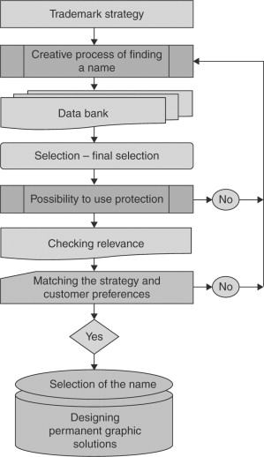
FLOWCHART:

Slide 4
Overview:
Problem Definition
Flow chart

Slide 5
RECOMMENDATION:
The bank should target these customers with customized offerings to further increase its revenue.
The bank should further weed out the base of non-profitable 1316 customers (falling in Q1) to reduce the cost that incurs in their retention.
The bank should further segment the profitable customers to move them up to the higher profitability bands, for example from Q2 to Q3 and from Q3 to Q4 by suitably nurturing them.

Slide 6
CONCLUSION:
The outcome of this study is based on a data-driven analytical approach that will empower the bank to devise an effective marketing strategy to increase its profitability by targeting potential customers from its existing customer base, thus ensuring optimization of resources.

